Slide 1
Intro to Unity – Random, Input Keys

Slide 2
Generate a Random #
Random.Range (-5, 5)
Generates a random value between -5 and 5

Slide 3
Input Key Strokes
Tie a key to an action
Command: Input.GetKey ("d")
If the “d” key is pressed, the code following the command will be executed
Example:
if(Input.GetKey(“d”))
{
Debug.Log(“the deee key was pressed!”);
}

Slide 4
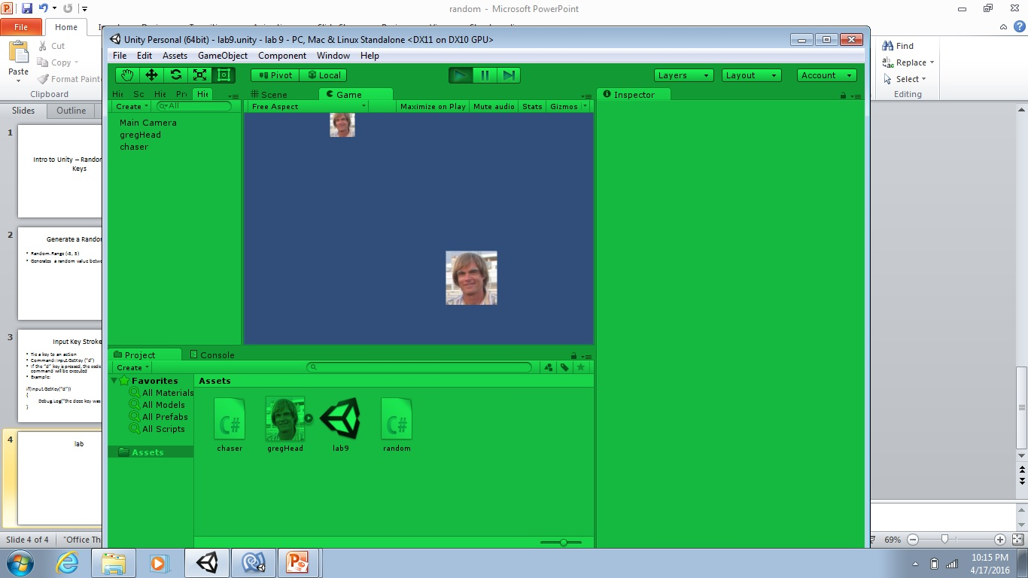
Lab – Chase the GameObject
control motion with
4 keys of your choice
continuously moves
randomly in x, y

Slide 5
Lab Hint
Do one axis first (like x) , then add the other (y)

